Slide 1
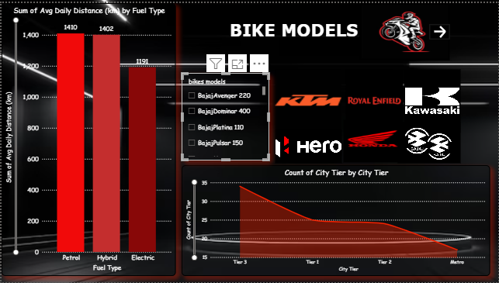
BIKE MODELS DASHBOARD
Petrol and Hybrid bikes show the highest daily distance usage with around 1410–1402 km, while Electric bikes cover slightly less at 1191 km.
Bajaj models such as Avenger 220, Domina 400, Platina 110, and Pulsar 150 dominate user preferences.
Popular brands featured include KTM, Royal Enfield, Kawasaki, Hero, Honda, and Bajaj, indicating strong competition in the market.
City tier analysis shows the majority of bike users are from Tier-3 cities, followed by Tier-1, Tier-2, and metro users.

Slide 2
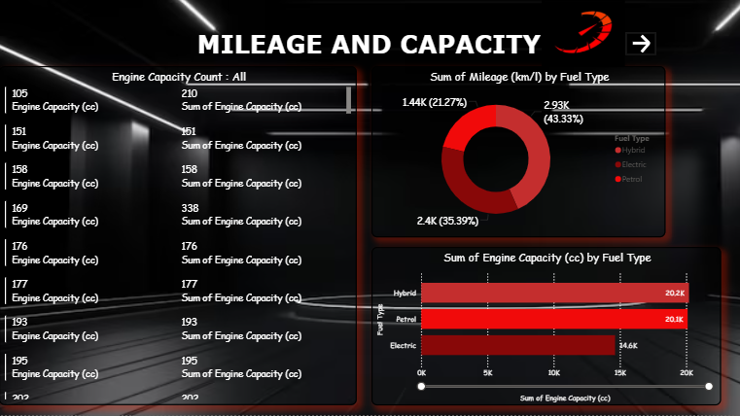
MILEAGE AND CAPACITY
Engine capacity varies widely across bikes, ranging from 105cc to 338cc, with notable usage in multiple categories.
Fuel-wise mileage distribution:
Hybrid bikes contribute the highest share (43.33%).
Petrol bikes follow with 35.39%.
Electric bikes make up 21.27%.
Engine capacity by fuel type:
Hybrid: 20.2K cc,
Petrol: 20.1K cc,
Electric: 14.4K cc.
Engine capacity by fuel type:
Hybrid: 20.2K cc,
Petrol: 20.1K cc,
Electric: 14.4K cc.

Slide 3
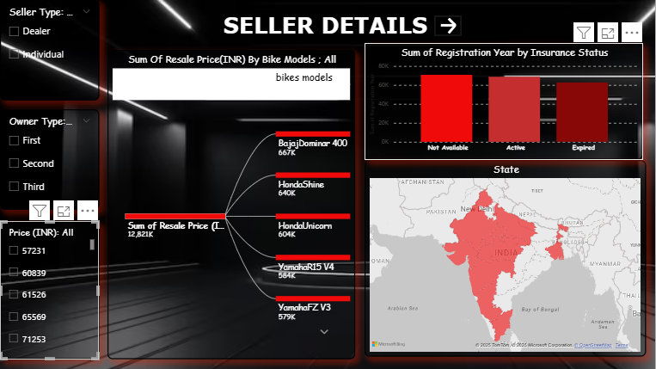
SELLER DETAILS DASHBOARD
Resale price analysis highlights top models:.
Bajaj Dominar 400 (₹667K),
Honda Shine (₹640K)
Honda Unicorn (₹604K)
Yamaha R15 V4 (₹584K)
Yamaha FZ V3 (₹579K)
Total resale market value captured is around ₹12.82L.
Seller types include Dealers and Individuals, with different ownership stages (First, Second, Third)
Registration by insurance status shows balanced distribution between Active, Expired, and Not Available
Geographical data highlights major bike activity concentrated in states like Delhi, Maharashtra, and surrounding regions.

Slide 4
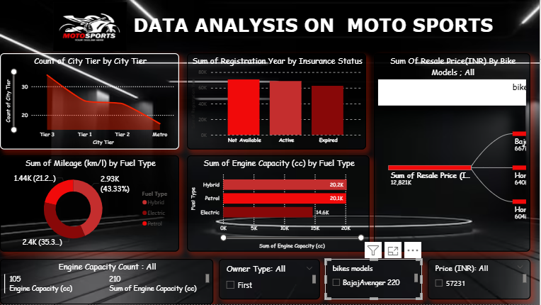
FINAL DASHBOARD
City Tier Analysis
Majority of bikes are registered in Tier 3 cities, followed by Tier 2 and Tier 1.
This indicates higher market penetration in semi-urban and rural areas.
Insurance Status
Registrations are fairly balanced across Active, Expired, and Not Available categories.
Highlights the need for better insurance awareness.
Mileage by Fuel Type
Petrol bikes dominate with 2.9K km/l (43.33%).
Hybrid contributes a small portion (1.44K km/l), while electric remains minimal.
Engine Capacity (cc) by Fuel Type
Petrol bikes show the highest engine capacity (20.1K cc).
Electric and Hybrid models have limited engine presence compared to petrol.
Resale Price Analysis
Popular bike models like Bajaj Avenger 220 and Honda models dominate resale value.
Resale prices cluster around ₹57,231 average

